Slide 1

HOUSING- PRICE PREDICTION
BY: ARGHA KUMAR MAITI

Slide 2
Objective:
Required to model the price of houses with the available independent variables. This model will then be used by the management to understand how exactly the prices vary with the variables. They can accordingly manipulate the strategy of the firm and concentrate on areas that will yield high returns. Further, the model will be a good way for the management to understand the pricing dynamics of a new market.

Slide 3
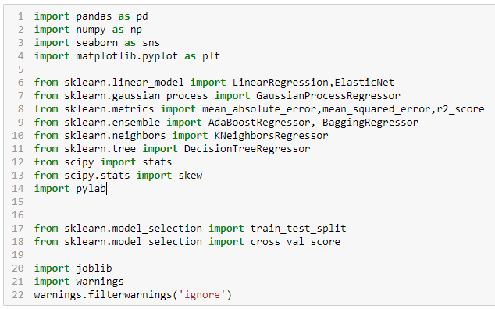
Let's import required libraries:

Slide 4
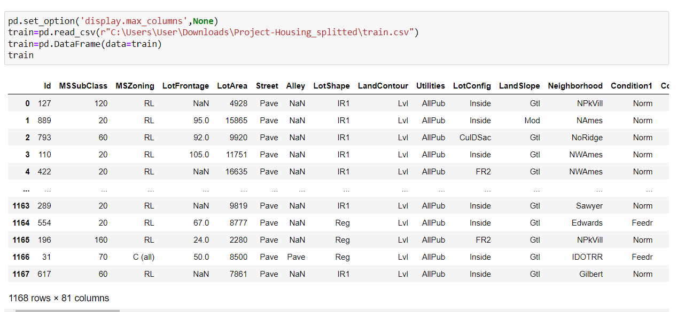
We will import the train file for analysis now:

Slide 5
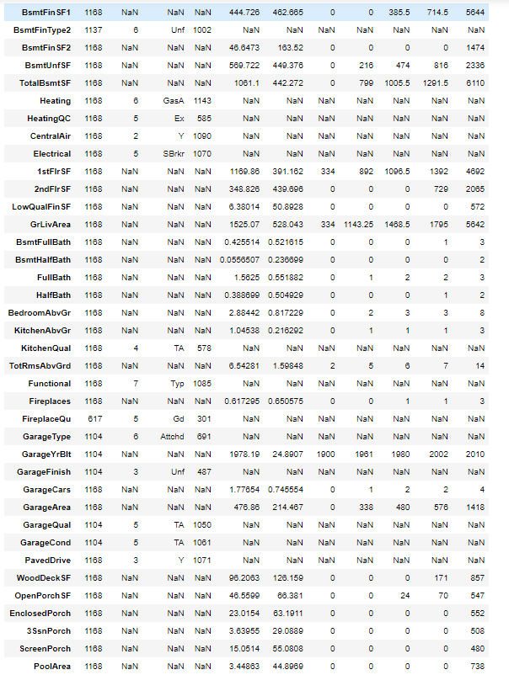
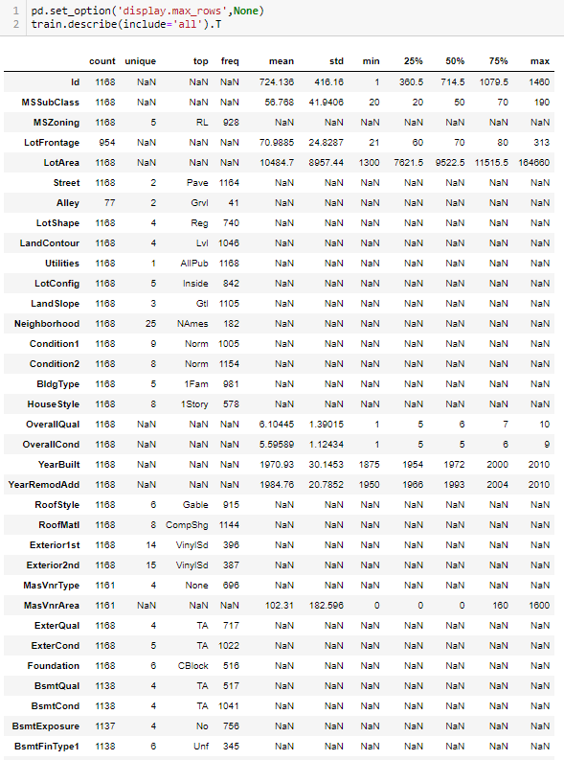
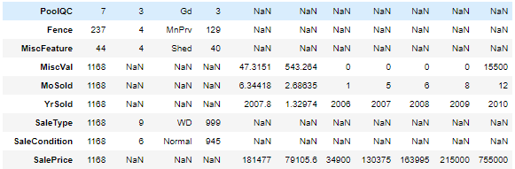
Describing the dataset:

Slide 6
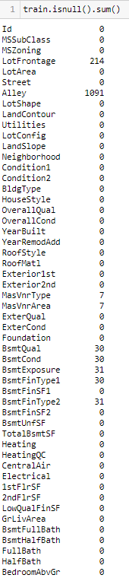
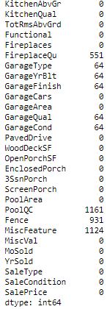
We can see null values in LotFrontage, Alley, MasVnrType, MasVnrArea, BsmtQual, BsmtCond, BsmtExposure, BsmtFinType1, BsmtFinType2, FireplaceQu, GarageType, GarageYrBlt, GarageFinish, GarageQual, GarageCond, PoolQC, Fence and MiscFeature.
Dropping columns which has too many null values i.e. Alley, FireplaceQu, PoolQC, Fence, MiscFeature. Also we will be working on null values according to datatype of the particular column.
Utilities variable has only one unique data in it hence we dropped it

Slide 7
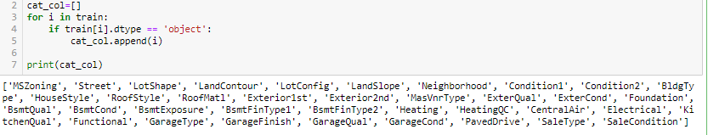
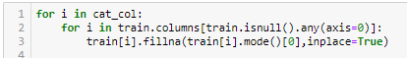
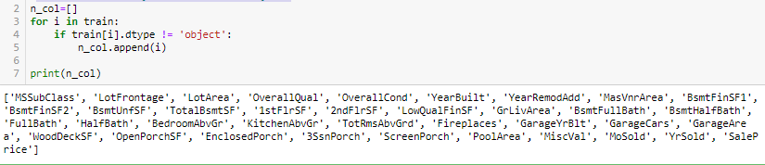
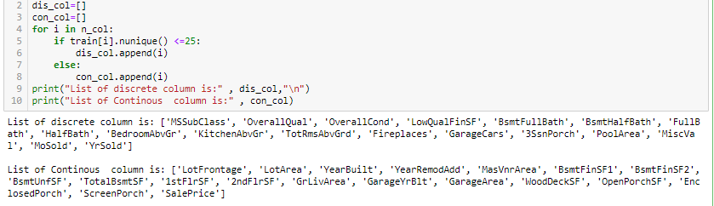
Making lists based on type of data in variables and working on null values:

Slide 8
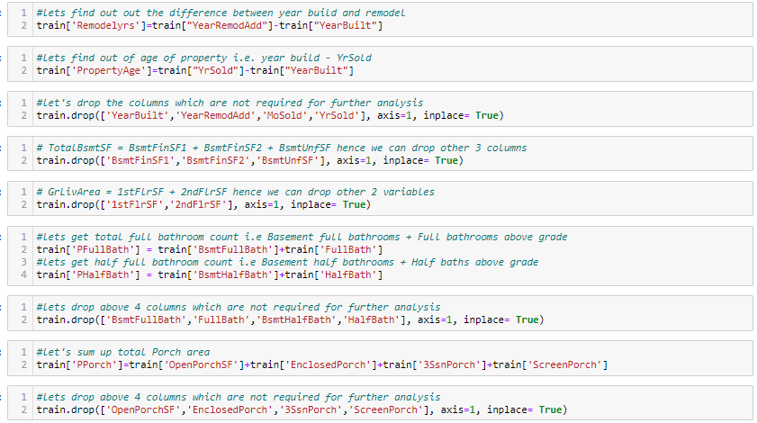
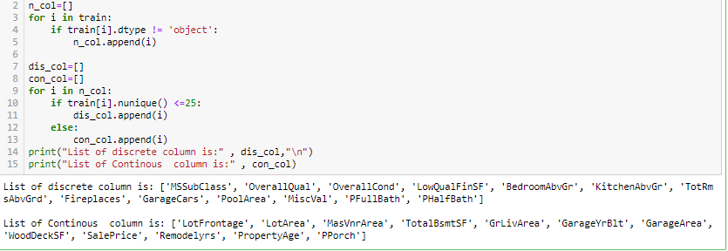
let's create a new list after working on numerical variables
Before proceeding ahead let’s do some data pre-processing:

Slide 9
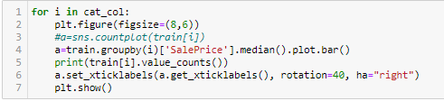
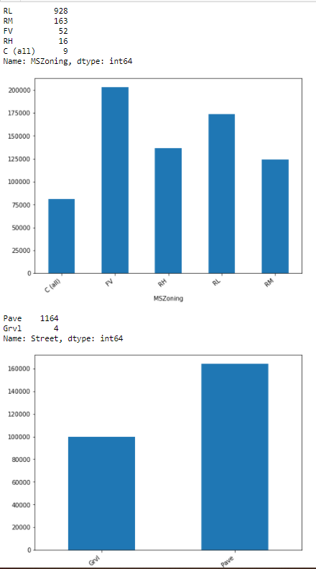
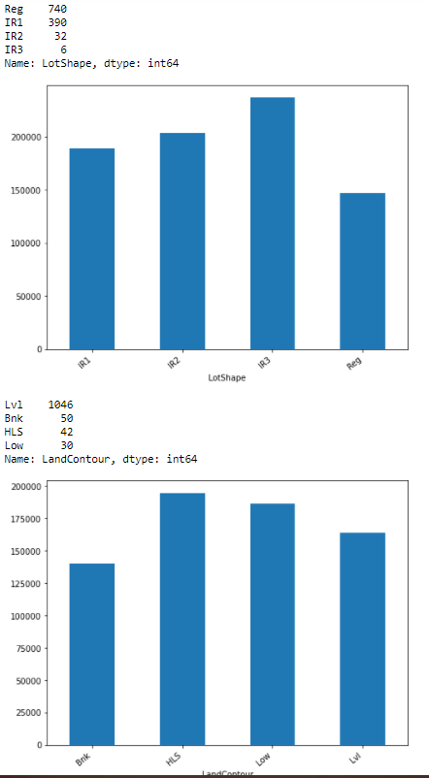
Visualization:

Slide 10
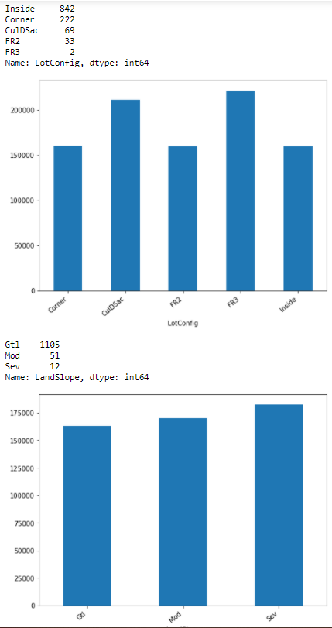
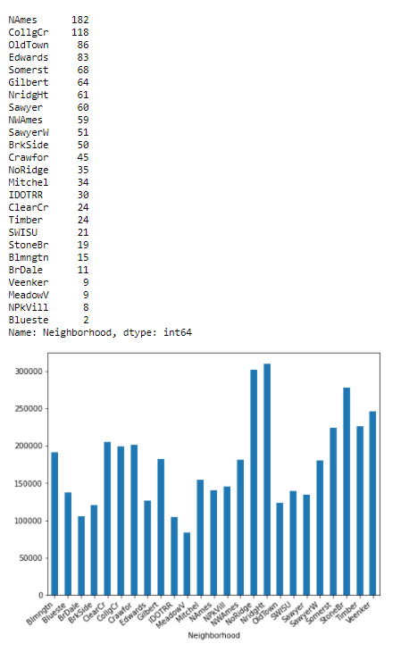
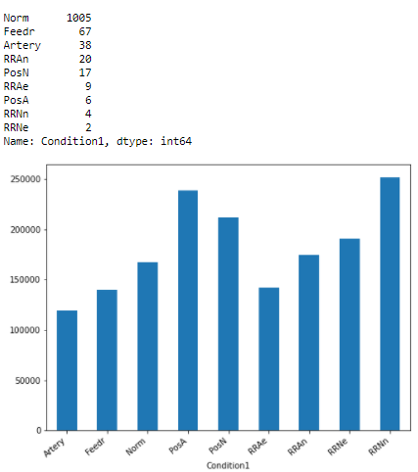
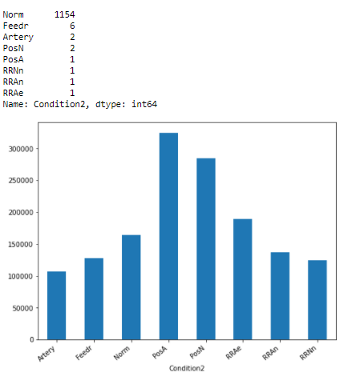

Slide 11
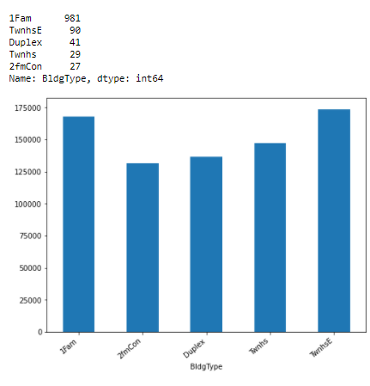
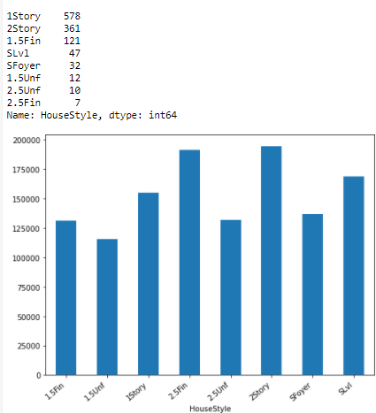
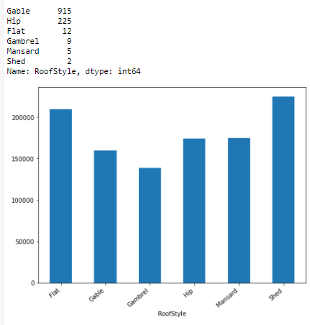
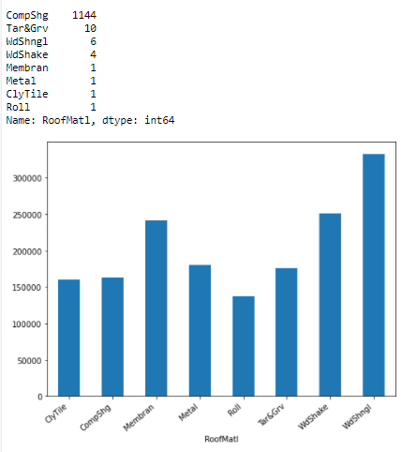
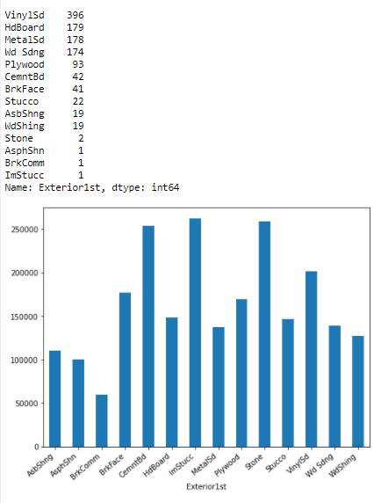
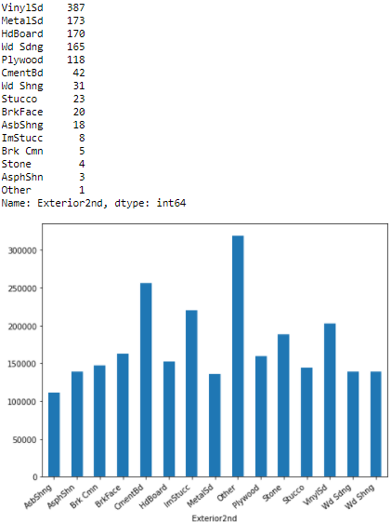

Slide 12
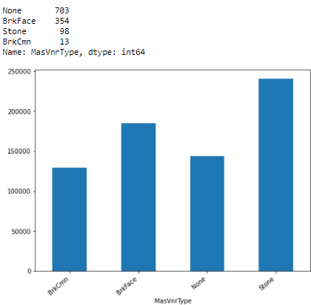
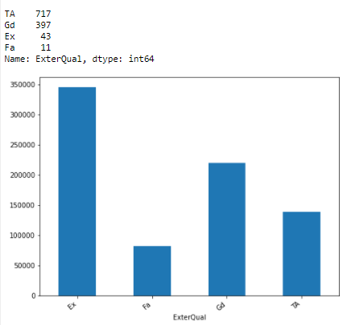
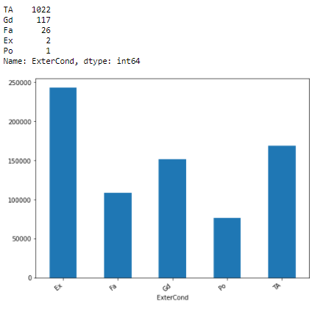
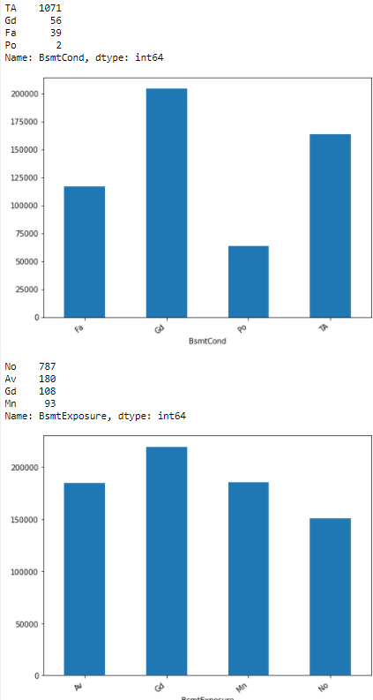
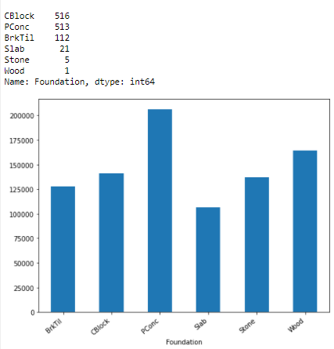
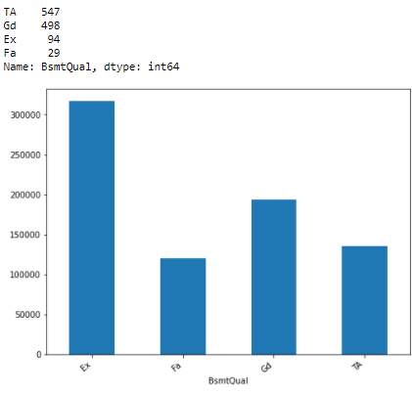
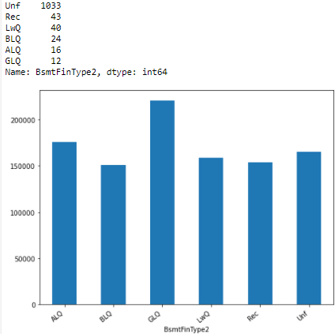

Slide 13
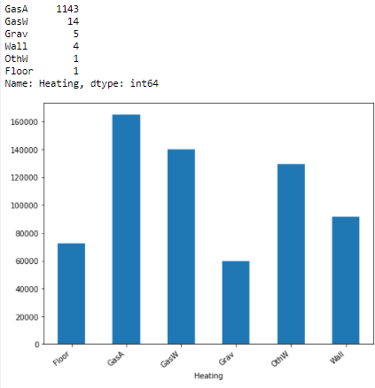
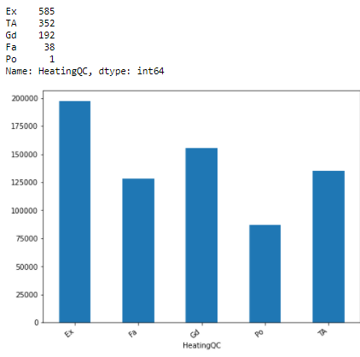
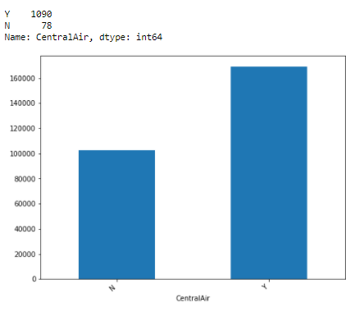
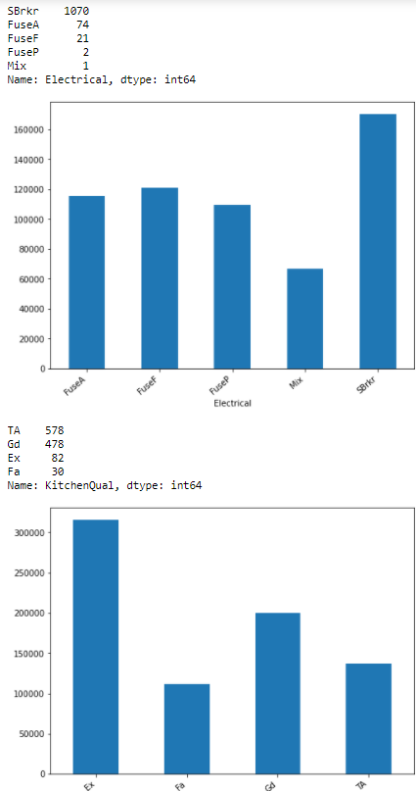
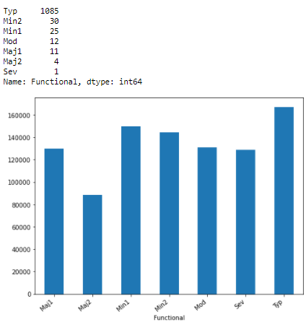
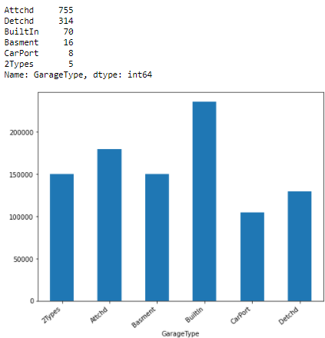

Slide 14
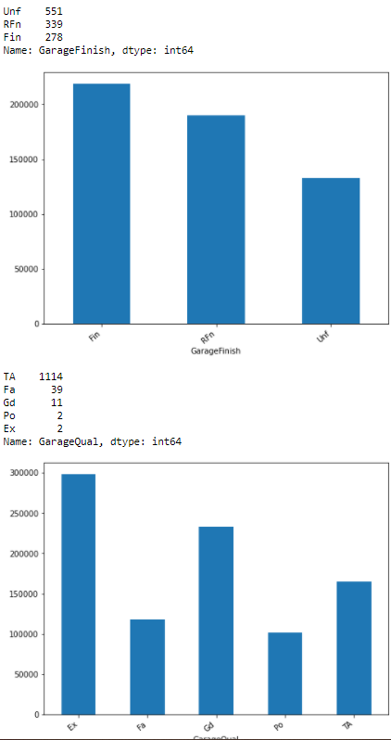
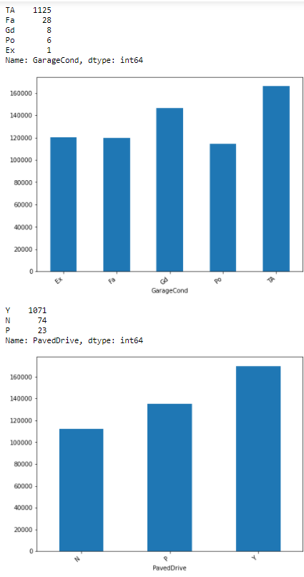
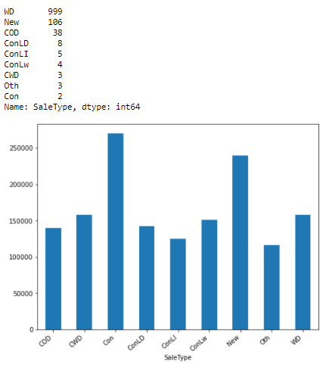
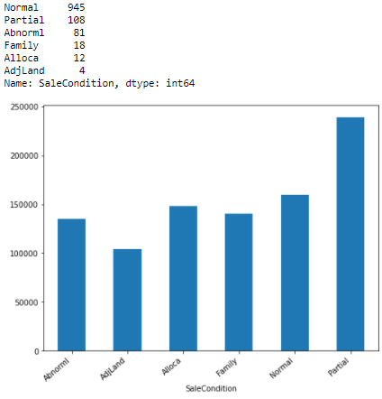

Slide 15
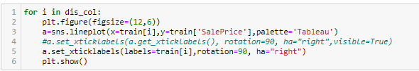
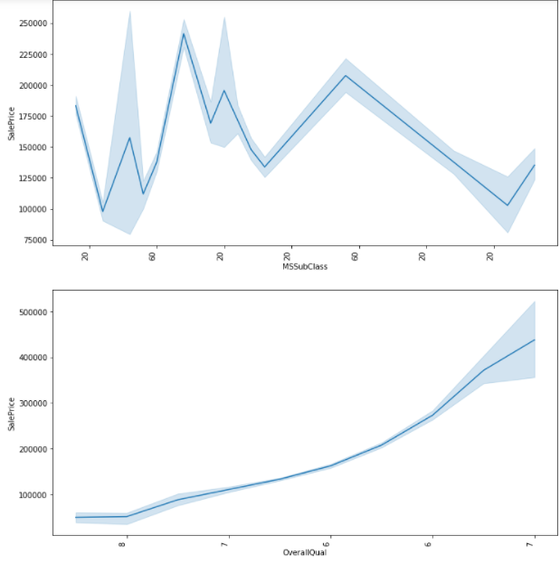
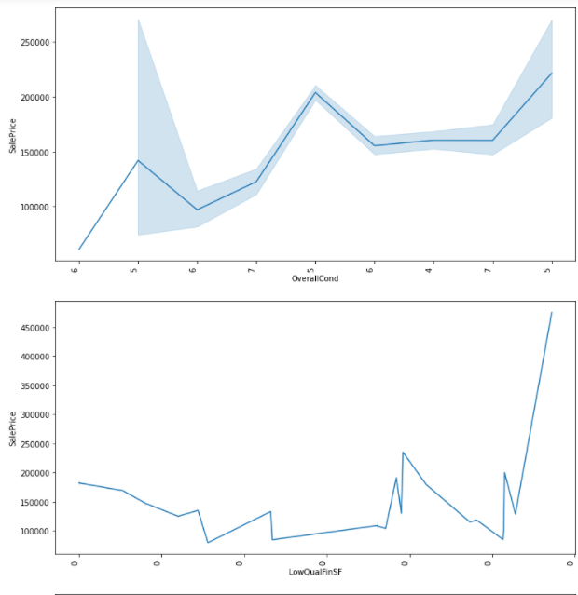
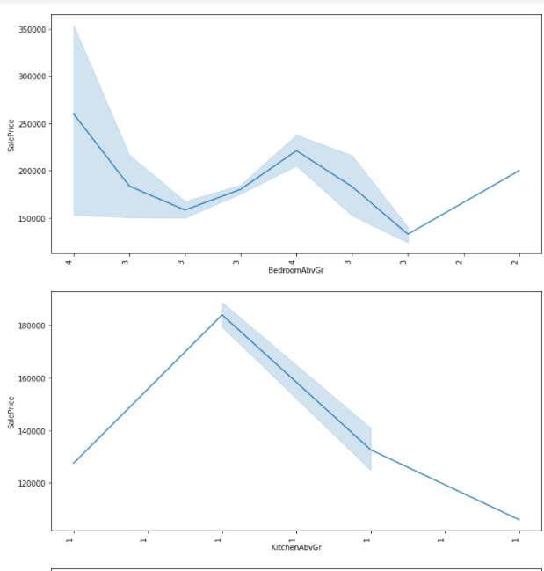
Let’s have a look at discrete variable data:

Slide 16
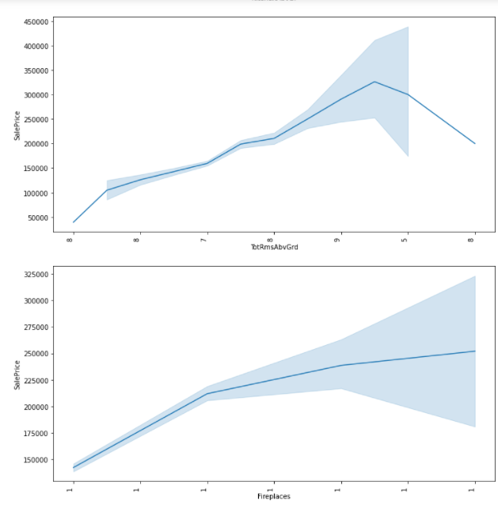
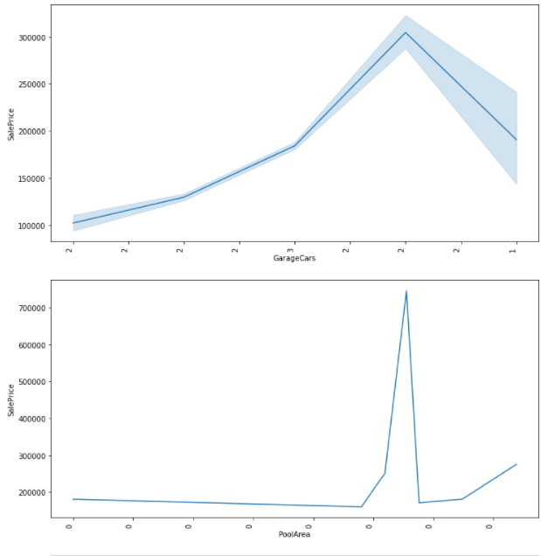

Slide 17
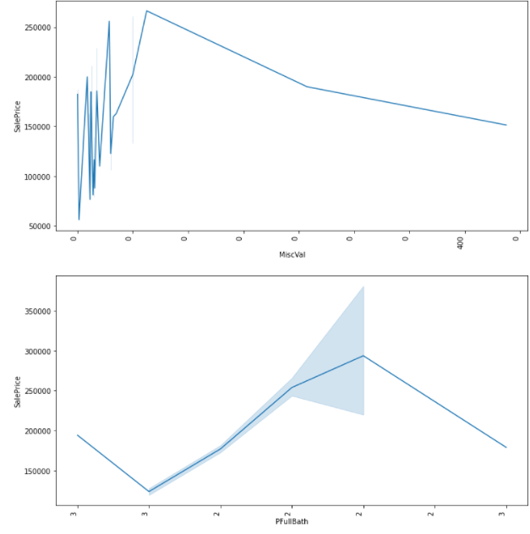


Slide 18


Let’s look at continuous variable data:

Slide 19




Slide 20



Let’s check the distribution of data now:
We can see for numerical columns data is not evenly distributed.

Slide 21



We can see positive relation between overallQual and SalePrice.
We can see positive relation between GrLivArea and SalePrice.
We can see positive relation between TotalBsmtSF and SalePrice.

Slide 22



We can see positive relation between GarageCars and SalePrice.
We can see positive relation between GarageArea and SalePrice.
We can see positive relation between PFullBath and SalePrice.

Slide 23



We can see negative relation between BsmtQual and SalePrice.
We can see negative relation between ExterQual and SalePrice.
We can see negative relation between KitchenQual and SalePrice.

Slide 24


We can see negative relation between GarageFinish and SalePrice.
We can see negative relation between PropertyAge and SalePrice.

Slide 25

Let’s check for outliers with the help of boxplot:
We can see outliers in all numerical variables.

Slide 26



Some functions for further analysis:

Slide 27




Let's Work on features individually:
LotFrontage

Slide 28




LotArea

Slide 29


MasVnrArea
TotalBsmtSF

Slide 30




GrLivArea

Slide 31




GarageYrBlt

Slide 32


GarageArea
WoodDeckSF

Slide 33


Remodelyrs
PropertyAge

Slide 34

PPorch

Slide 35


Let's look at the correlation:
We need to check the correlation of all columns with or target column 'SalePrice' however where datatype of columns is Object hence we cannot see those columns.
Let's change the data type of other object type columns.

Slide 36


The list columns has very less correlation with our target column, hence we can drop those.
BsmtCond
Street
Condition2
LandContour
BsmtFinType2
LandSlope
MasVnrType
MiscVal
LowQualFinSF

Slide 37



Skewness and outliers removal:
We have already delt with outliers
We do not consider skewness for target variable sales price and categorical and discrete variables.

Slide 38

Let's perform scaling now:

Slide 39


We will import the test file now:

Slide 40



We can see count is all same for all variable, let's check for null values now:
We can see null values in LotFrontage, Alley, MasVnrType, MasVnrArea, BsmtQual, BsmtCond, BsmtExposure, BsmtFinType1, BsmtFinType2, Electrical, FireplaceQu, GarageType, GarageYrBlt, GarageFinish, GarageQual, GarageCond, PoolQC, Fence and MiscFeature.
Dropping columns which has too many null values i.e. Alley, FireplaceQu, PoolQC, Fence, MiscFeature. Also we will be working on null values according to datatype of the particular column.

Slide 41



Lets create lists depend upon type of data in variable

Slide 42

Let’s do some preprocessing of test dataset:

Slide 43




Visualization:

Slide 44






Slide 45








Slide 46







Slide 47







Slide 48





Slide 49






Slide 50






Slide 51



Slide 52




Slide 53


We can see for numerical columns data is not evenly distributed.
We can see outliers in all numerical variables.

Slide 54




Let's Work on features individually
LotFrontage

Slide 55




LotArea

Slide 56


MasVnrArea
TotalBsmtSF
Transformation functions are not working for MasVnrArea column.

Slide 57




GrLivArea

Slide 58




GarageYrBlt

Slide 59


GarageArea
WoodDeckSF

Slide 60


Remodelyrs
PropertyAge

Slide 61


PPorch

Slide 62



Skewness and outliers removal:
We have already delt with outliers.

Slide 63

Lets perform standardization:

Slide 64



Model/s Development and Evaluation
Finding best random state:
Cross Validation of model:
With AdaBoostRegressor model there is very less difference in accuracy and cross validation score, Hence the best model is AdaBoostRegressor as per cross validation. Let's perform some hyper parameter tunning on models

Slide 65


Hyper parameter tunning:
LinearRegression

Slide 66




AdaBoostRegressor
ElasticNet

Slide 67


KNeighborsRegressor
DecisionTreeRegressor

Slide 68



BaggingRegressor
After performing RandomizedSearchCV method accuarcy:
Selecting DecisionTreeRegressor as final model for saving, As can see some models are over fitted.

Slide 69


Load The Model
Prediction Over Test Data

Slide 70
Conclusion:
House price is depend upon various aspects.
Building a data science model for the management to understand the pricing dynamics of a new market. Our train dataset contains 1460 entries each having 81 variables and also contains Null values. And the test dataset contains 292 entries each having 80 variables and also contains Null values. I have worked on null values. Then created some new variables and deleted some which were not required after creating new variables. Then worked on outlier and skewness of the data for both the dataset. As our dataset contains object and numerical data hence with the help of ordinal encoding method, I have changed the data type to numeric and then standardization method help me in making the data in standard format. Then tried finding the best random state to work on, after that we stated 6 models on our train dataset and with the help of GridsearvhCV method i tried to improve the accuracy, I choose DecisionTreeRegressor for final saving the model the then loaded the model on test dataset and then predicted the data over test dataset.

Slide 71
THANK YOU ☺

